Slide 1
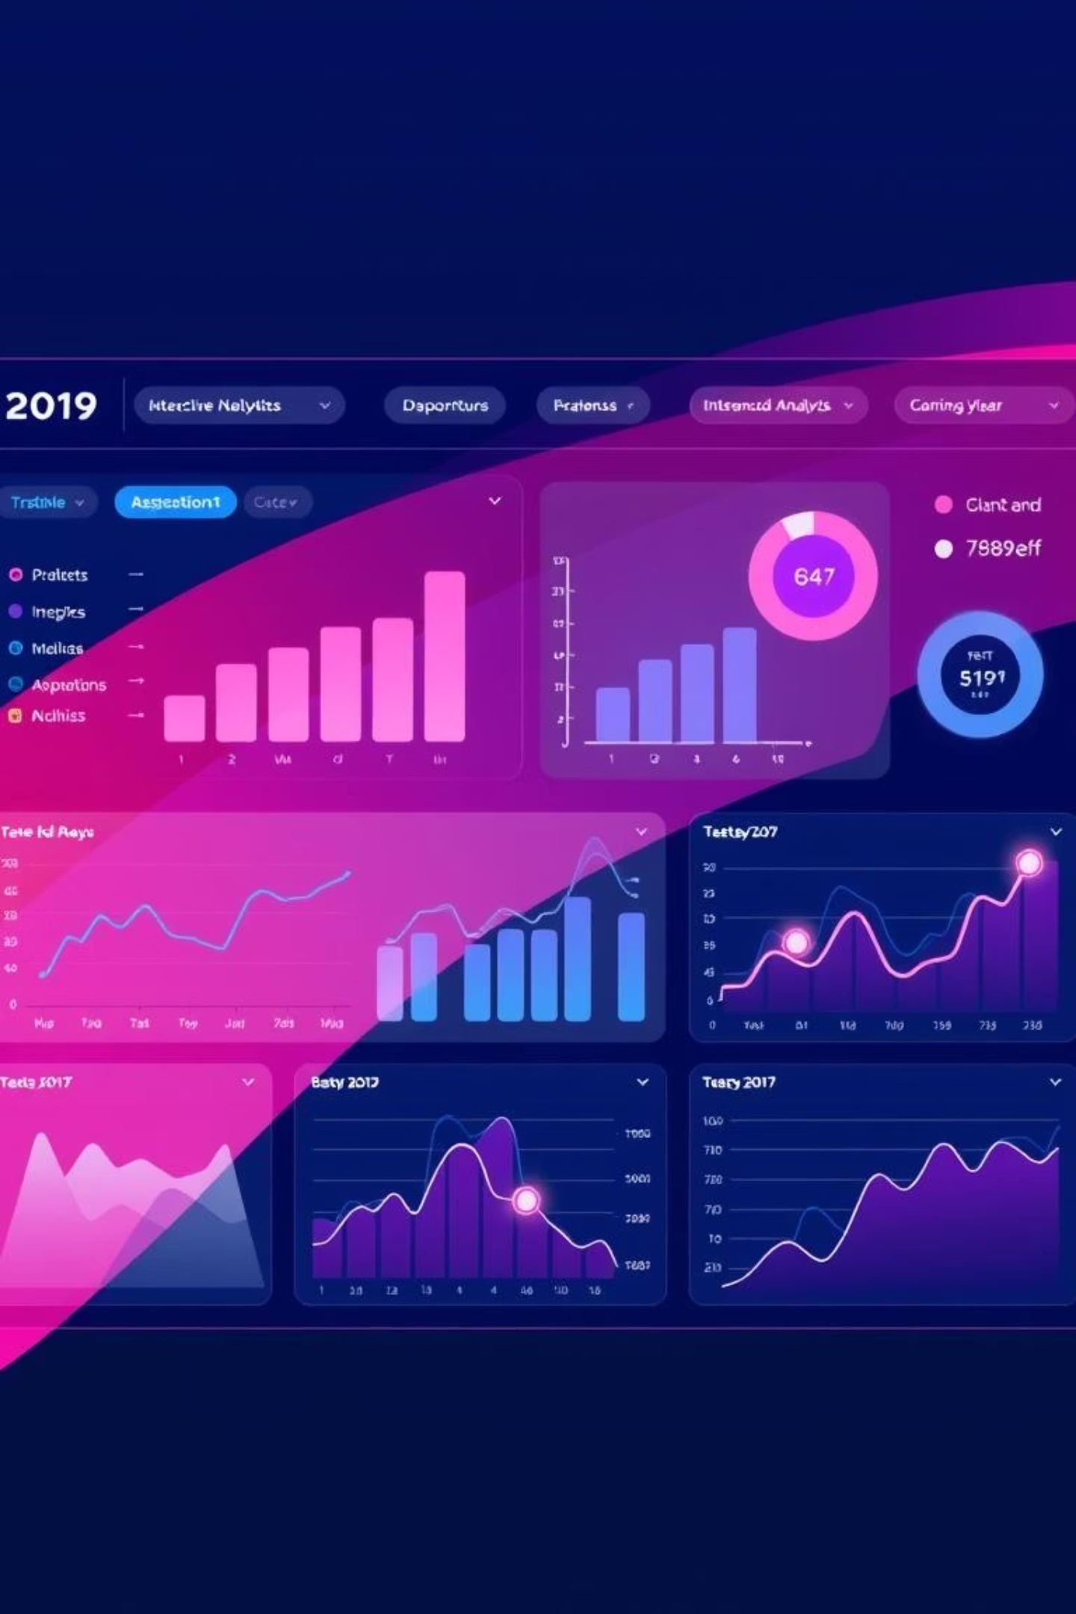

Techno Sales Dashboard Analysis (2020-22)
An interactive Power BI dashboard for deep sales insights and performance reviews.
Presented by [ Faizan Ahmad Khan ] | [2402160140017] | [MCA] | [IMT College Of Engineering] |

Slide 2
Project Overview
Objective
Data Preparation
Analyze Techno Sales data (2020-22) using Power BI for actionable insights.
Data cleaning and modeling using Power Query and Star Schema design ensured accuracy.
Dashboard Features
Key Focus Areas
Interactive dashboard with clustered column chart, slicers, and geographical visualizations.
Focused analysis on supervisors, categories, and state-wise sales performance.

Slide 3

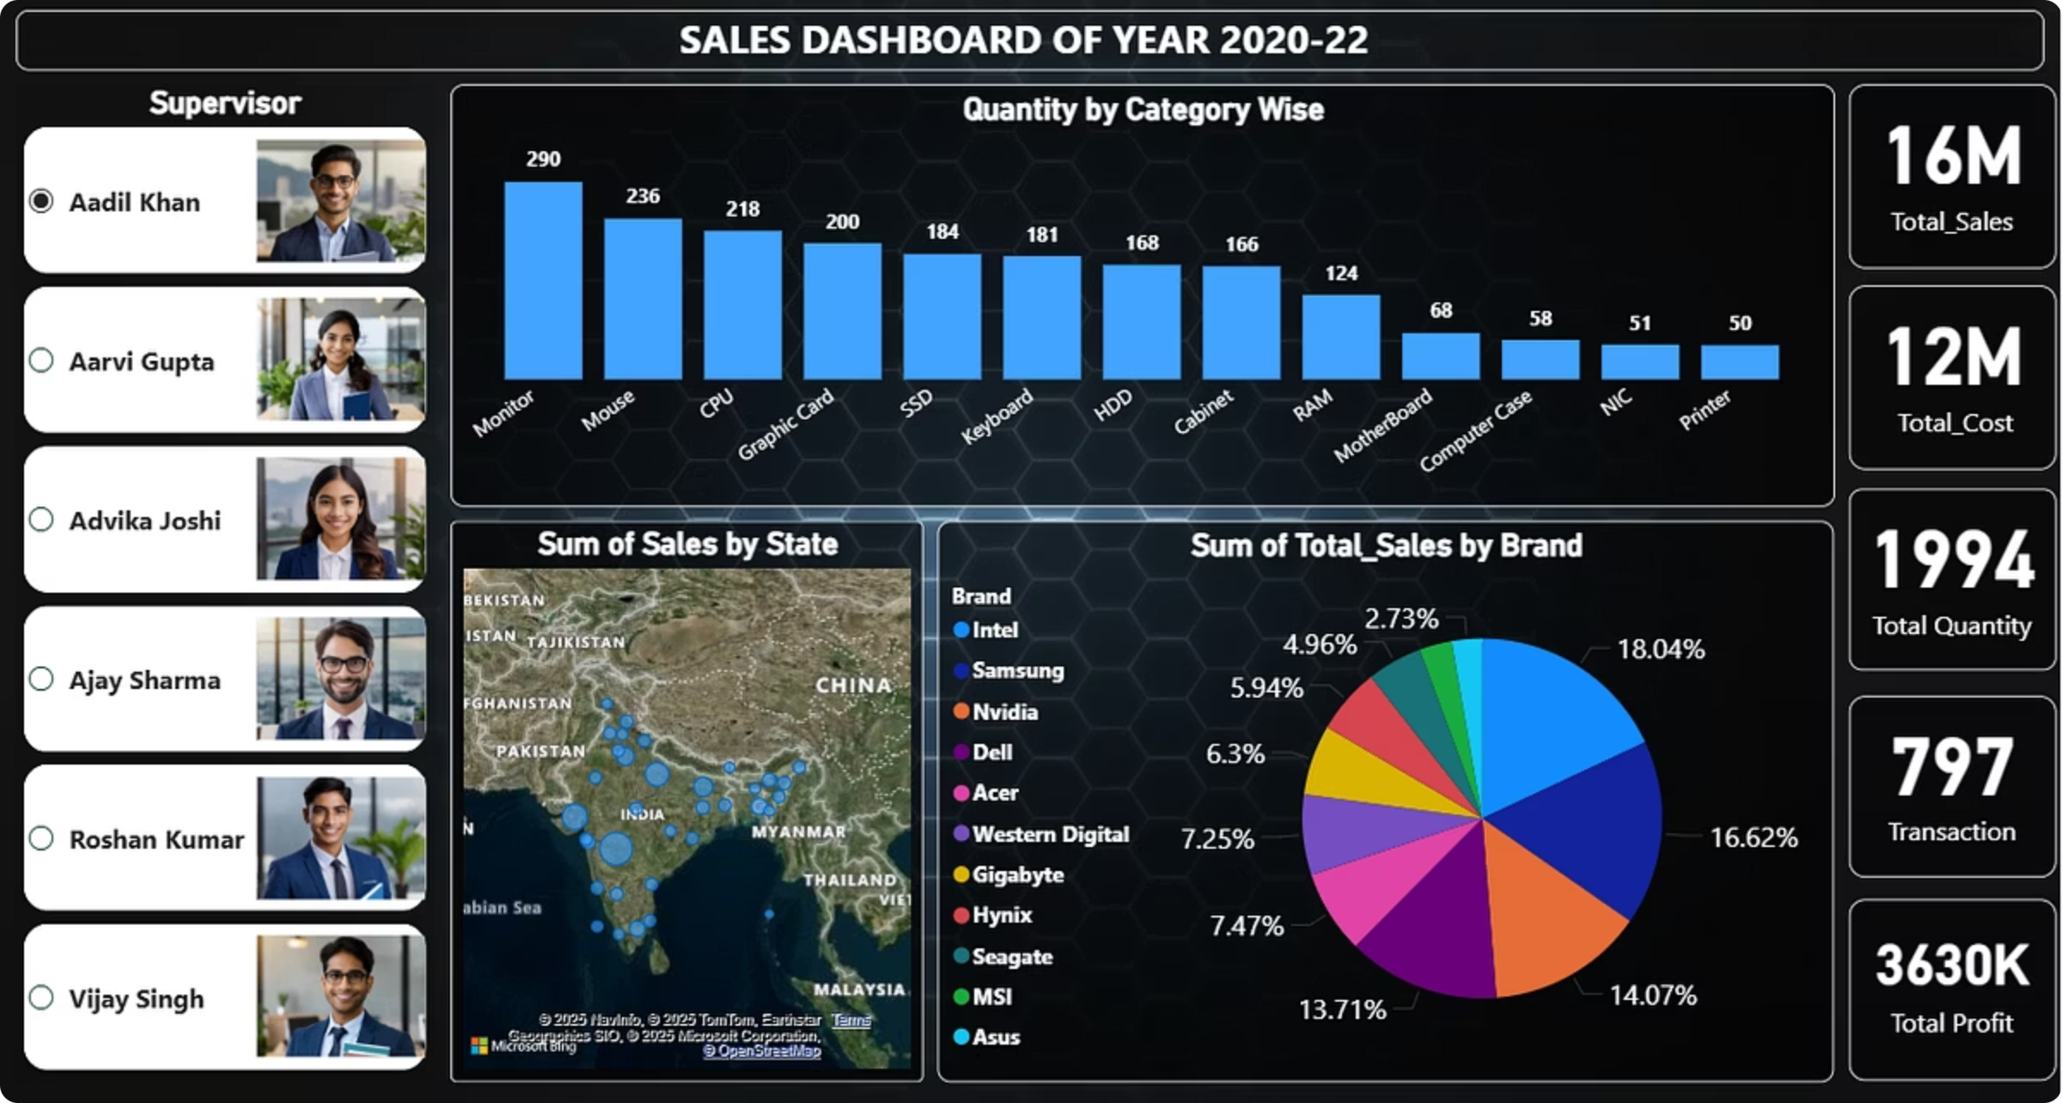
Overall Sales Dashboard: A Comprehensive View
This full view of the Power BI dashboard provides a snapshot of overall sales performance from 2020 to 2022, highlighting key metrics and trends.

Slide 4
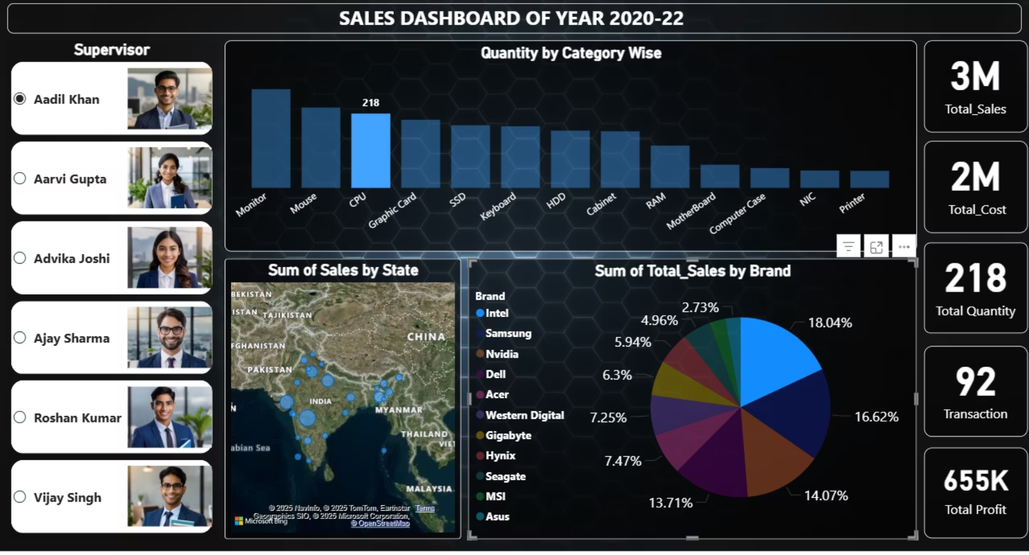
Performance Spotlight
Supervisor Performance: Aadil Khan
Aadil Khan consistently demonstrates strong sales leadership, with high performance across various categories. His team's regional sales data shows significant contribution to overall revenue.
Consistent High Sales
1
Maintains top performance year-over-year.
Strong Regional Impact
2
Significant revenue generation from his assigned territories.

Slide 5
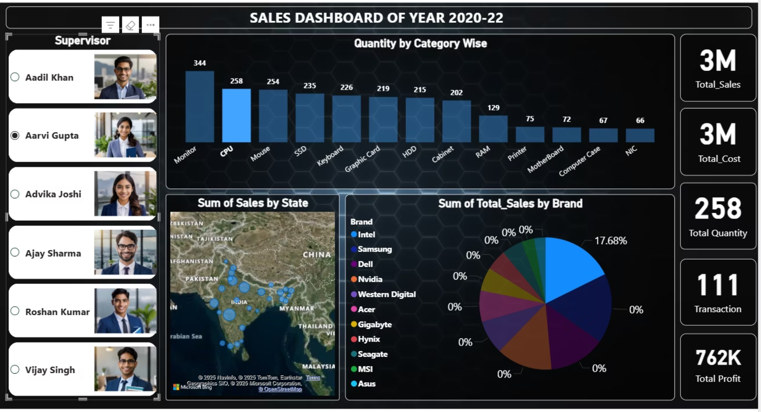
Performance Spotlight
Aarvi Gupta's dashboard view showcases her strategic approach to sales, excelling in specific product categories and driving substantial growth in her regions. Her detailed performance breakdown offers insights into effective sales strategies.
Supervisor Performance: Aarvi Gupta
Strategic Category Focus
1
Excels in key product segments.
Driving Growth
2
Consistently contributes to overall sales expansion.

Slide 6





Key Insights from Sales Data
Top State Contribution
Product Category Leaders
The top 5 states collectively account for 65% of total revenue, indicating concentrated market strength.
SSDs and Graphic Cards are the highest-selling product categories, reflecting strong demand in the tech sector.
Top Supervisors
Leading Brands
Aadil Khan and Aarvi Gupta are key contributors to sales volume, demonstrating effective leadership and sales strategies.
Intel, Samsung, and Asus dominate total sales by brand, showcasing strong consumer preference and market presence.

Slide 7








Strategic Recommendations
Optimize Inventory
Targeted Marketing
Increase stock for SSDs and Graphic Cards to meet sustained high demand and prevent stockouts.
Launch marketing campaigns in underperforming states to expand market reach and boost sales.
Incentivize Sales Teams
Continuous Monitoring
Introduce incentive programs for supervisors and their teams to further motivate and boost sales performance.
Regularly update and review the Power BI dashboard to monitor performance trends and adapt strategies.

Slide 8
Closing Statement
Conclusion: Empowering Data-Driven Decisions
This Power BI project clearly demonstrates how interactive dashboards empower data-driven decisions within sales operations.
We successfully cleaned and modeled raw sales data, transforming it into a decision-ready format for immediate use.
The intuitive and interactive dashboard provides stakeholders with clear visibility into performance.
The project delivered actionable insights crucial for optimizing inventory management and strategic planning.

Slide 9

Thank You
We appreciate your time and attention.

